Slide 1
CS 3843 Computer Architecture
Instructor: Dr. Vijayalakshmi Saravanan
Copyright Saravanan, Muzahid, Torrellas 1999, 2001, 2002, 2012, 2013, 2014, 2017

Slide 2
Computer Architecture Recitation
Location: NPB 1.226
It has about 40 Linux workstations running 14.04
There will be TAs or tutors available most week days from 9-5.
Your degree will probably be more enjoyable if you spend time in the Lab.

Slide 3
Attendance
Attendance is required.
A class sign-in sheet will be passed around except on Exam days and today.
I need a volunteer who will remind me to pass around the sheet about 10 minutes into the class. This is worth 5 points for the entire semester.

Slide 4
syllabus

Slide 5
Textbooks
Computer Architecture: A Quantitative Approach", fifth edition, by Hennessy and Patterson. We will follow this book in class.
Course Components
Lectures
Higher level concepts
Recitations
Applied concepts, important tools and skills for labs, clarification of lectures, exam coverage
Exams (midterm + final)
Test your understanding of concepts & mathematical principles

Slide 6
Getting Help
Staff mailing list: Vijayalakshmi.Saravanan@utsa.edu
Office hours (Monday &Wednesday Starting Sep 1, 2017 onwards) at 1.00-3.00 PM:
MW, 1.00-3.00pm
Office: NPB 3.308
1:1 Appointments
You can schedule 1:1 appointments by email

Slide 7
Other Rules of the Lecture Hall
Laptops: permitted
Electronic communications: No email, instant messaging, cell phone calls, etc
Presence in lectures, recitations: Surprise quizzes (attendance), Mandatory
No make-up quizzes.
No recordings of ANY KIND

Slide 8
Policies: Grading
Exams: midterm (35%), final (35%)
35% Midterm Exams
20% Assignments
5% Quizzes and Class Participation
5% Class Attendance
35% Final Exam
The same grade is assigned for CS 3843 and CS 3841.

Slide 9
Background
Assume you have taken:
A basic computer organization course
A logic design course
Assembly language programming
Assume that you know
What an instruction set looks like
How to program in C

Slide 10
Course Goals
Introduce you to design principles, analysis techniques and design options in computer architecture
Instruction set design
Memory-hierarchy design
Pipelining
Multiprocessor design (if time permits)
The use of cost/performance as a basis for making decisions about computer architecture
Get you to ask interesting questions about computer architecture

Slide 11
Grading
Grading: Final grades will be computed based on the following: two midterms 35%, final 35%, homework & machine problems 20%, class attendance and quizzes 10%.
The same grade will be assigned both for main course and its recitation. No late assignments will be accepted. There will be unannounced quizzes at the end of some classes.

Slide 12
Welcome and Enjoy!

Slide 13
Chapter 1 (Book Readings: H&P Ch 1)
Fundamentals of Design and Analysis
Performance improvements:
Improvements in semiconductor technology
Feature size, clock speed
Improvements in computer architectures
Enabled by HLL compilers, UNIX
Lead to RISC architectures
Together have enabled:
Lightweight computers
Productivity-based managed/interpreted programming languages

Slide 14
What is Computer Architecture
Computer Architecture =
Instruction Set Architecture +
Organization + Hardware + …
The Instruction Set: a Critical Interface
software
instruction set
hardware

Slide 15
Name some processors

Slide 16
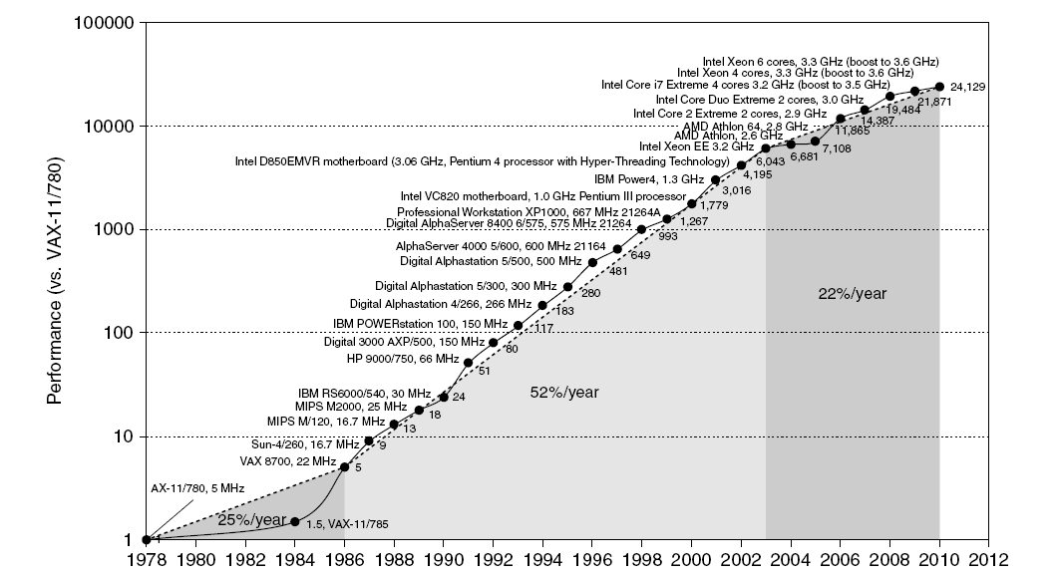
Single Processor Performance
Move to multi-processor
22%
RISC
52%
25%
Notes:
Since 2003, hurdles are power and ilp
Steady growth for last 20 years. Impact:
More power to users
Different type of computers: cell phone, tablet, laptop etc
Dominance of microprocessor-based computers instead of mini computers or mainframe or even supercomputers
Trade off performance for productivity. Python, ruby instead of c, c++

Slide 17
Challenges??

Slide 18
Challenges
Performance
Parallelism constraint => Instruction level parallelism (ILP) Wall
Energy
Power is not free => Power Wall
Memory
Memory is slow => Memory Wall

Slide 19
Type of Computers??

Slide 20
Classes of Computers
Personal Mobile Device (PMD)
e.g. smart phones, tablet computers
Emphasis on energy efficiency and real-time
Desktop Computing
Emphasis on price-performance
Servers
Emphasis on availability, scalability, throughput
Clusters / Warehouse Scale Computers (Data Centers)
Used for “Software as a Service (SaaS)”
Emphasis on availability and price-performance
Sub-class: Supercomputers, emphasis: floating-point performance and fast internal networks
Embedded Computers
Emphasis: price and energy

Slide 21
Performance of a Computer??

Slide 22
Computer A performs better than B
What does it mean?
A) A has higher clock rate than B
B) A can finish more tasks than B within a period of time
C) A can finish a task faster than B
D) A has more cores than B

Slide 23
Performance
Response time
Time from start to completion of an event
Execution time
Latency
Throughput
Amount of work done per unit time
Bandwidth

Slide 24
Performance
Program execution time is the measure of performance (seconds/program)
Definition of execution time
wall clock time, elapsed time as seen by user includes everything disk, OS overhead, competition with other jobs .
CPU time: time CPU computing on your program. Excluding I/O wait time
1. User CPU time
2. System CPU time
CPU Performance: user CPU time
90.7s: user CPU time
12.9s: system CPU time
2:39: elapsed time
65%: CPU/elapsed

Slide 25
Performance
Execution time of a program in system B is 100s. System B is 10% faster than system A. What is the execution time in system A?

Slide 26
Performance
Execution time of a program in system B is 100s. System B is 10% faster than system A. What is the execution time in system A?
ANS:

Slide 27
Performance
System A is n% faster than system B – what does it mean?
(ET = Execution Time)
A)
B)
C)
D)

Slide 28
Performance
System A is n times faster than system B – what does it mean?
(ET = Execution Time)
A)
B)
C)
D)

Slide 29
Performance
System A is n times faster than system B – what does it mean?
(ET = Execution Time)
A)
B)
C)
D)
Speed up = n

Slide 30
Evaluating Performance
Use real programs
CAD, text processing, business applications, scientific applications
May not know what programs users will run
Kernels:
Small key pieces (inner loops) of scientific programs where program spends most of its time
e.g. Livermore loops, LINPACK
Amenable to hand analysis
Toy Programs
e.g. Quicksort, Puzzle
Easy to type, predictable results, may use to check correctness of machine but not as performance benchmark.

Slide 31
Evaluating Performance
Synthetic Benchmarks
Try to match average frequency of operations and operands of a large set of programs
Problem with toy and synthetic programs is that they do not stress the memory system
Benchmark suite
Collection of benchmark applications
SPEC
Problem with benchmarks in general is that once they become standardized they are susceptible to compiler targeting to improve price/performance

Slide 32
How do we summarize performance?

Slide 33
Summarizing Performance
Given n programs,
Average of execution time: arithmetic mean
(1/n)*(Time_1 + Time_2 + … + Time_n)
Example: ¼ *( 1 + 10 + 13 + 0.5 ) ms
Problem?

Slide 34
Summarizing Performance
Weighted arithmetic mean
(Time_1 * Weight_1 + Time_2 * Weight_2 + …+ Time_n * Weight_n)
where Weight_1 + Weight_2 + … + Weight_n = 1,
and Weight_j > 0
Example: 1 * 0.1 + 10 * 0.4 + 12 * 0.4 + 0.5 * 0.1
Problem?

Slide 35
Geometric mean for normalized Execution Time
Normalized execution time of a program j to the execution time in a reference machine
Geometric mean:

Slide 36
Execution time of some applications are 10s, 12s & 16s in system A and 5s, 3s & 2s in system B.
What is the normalized execution time w.r.t B?
0.5, 0.25, 0.125
2, 4, 8
5, 6, 8
2, 2.4, 3.2

Slide 37
Execution time of some applications are 10s, 12s & 16s in system A and 5s, 3s & 2s in system B.
What is the geometric mean of normalized execution time w.r.t B?
4
8
16
64

Slide 38
2 min
2 min
12 min
1 min

Slide 39
Make the common case fast
Very important, sort of obvious but often overlooked
The frequent case is often simpler and can be done faster (e.g. addition rarely overflows)
Complex problems should be handled in software
Hardware should provide fast primitives, not complete solutions

Slide 40
Amdahl’s Law
Performance gain from improvement of some portion of a computer
Original Observation: Speedup from parallel processing is limited by the fraction that cannot be parallelized.
In general,

Slide 41
Application of Amdahl’s Law
Parallel application that is 90% parallel, what is the speedup for application on 10, 100 and 1000 processors.
10% I/O and initialization:
90% parallel: (p processors)
S_p = 1/(0.1 + 0.9/p)

Slide 42
Application of Amdahl’s Law
Parallel application that is 90% parallel, what is the speedup for application on 10, 100 and 1000 processors.
10% I/O and initialization:
90% parallel: (p processors)
S_p = 1/(0.1 + 0.9/p)
S_10 = 1/(0.1 + 0.9/10) = 1/0.19 = 5.26
S_100 = 1/(0.1 + 0.9/100) = 1/0.109 = 9.1
S_1000 = 9.9
Diminishing returns in performance

Slide 43
Using Amdahl’s Law
Making cost performance trade-offs
Application spends 50% time in CPU and 50% of time waiting for I/O
Cost of CPU = 1/3, cost of I/O = 2/3
New CPU increases CPU performance 5 times and CPU cost 5 times
Is using a new CPU a good idea from a cost/performance standpoint.

Slide 44
Using Amdahl’s Law
Making cost performance trade-offs
Application spends 50% time in CPU and 50% of time waiting for I/O
Cost of CPU = 1/3, cost of I/O = 2/3
New CPU increases CPU performance 5 times and CPU cost 5 times
Is using a new CPU a good idea from a cost/performance standpoint.
Speedup = 1/ (0.5 + 0.5/5) = 1/0.6 = 1.67
Cost increase = 2/3*1 + 1/3*5 = 2.33
Spend resources proportionately to where time is spent
How much should we increase CPU speed for equal speedup and cost increase? Assume that if CPU performs x times, CPU cost increases x times. [ANS: 2]

Slide 45
Additional Exercises
When a programmer tries to parallelize a program, he uses multiple processors that speeds up the parallel section. However, this adds some overhead (e.g. synchronization overhead) in the program. Lets assume that, 60% of the program can be parallelized. If the programmer uses 10 processor, the parallel section is improved by a factor of 8. However, the synchronization overhead is 0.5% of the original execution time. What is the overall speed up of the program? (Ans. 2.083)
A programmer is considering an enhancement that will speed up 40% of the program by a factor of 3. Suddenly, he comes up with another enhancement that will further improve 30% of the first enhancement by a factor of 5. What is the overall speed up of using (i) just the first enhancement and (ii) both enhancements?
(Ans. 1.364, 1.426)

Slide 46
Recap Amdahls Law
Speedup = time_without enhancement / time_with enhancement
An enhancement speeds up fraction f of a task by factor S
Time_new = time_orig·( (1-f) + f/S )
S_overall = 1 / ( (1-f) + f/S )

Slide 47
Limitations of Amdahls law
Overestimates speedup achievable
Treats problem size as a constant
Shows how execution time decreases as number of processors increases
Could also be overly pessimistic

Slide 48
Measuring Performance
Latency: time to complete a task
This is normally what we want to reduce through parallelism
Speedup: ratio of latencies = Ts / Tp
• Linear speedup: speedup approximates P (Processors)
• Sublinear speedup: speedup less than P
• Superlinear speedup: speedup more than P
! Superlinear speedup happens when the algorithm or machine changes

Slide 49
Cont…
Throughput: work / Tp
Throughput can exploit parallelism, latency can’t
Higher throughput doesn’t imply lower latency
Efficiency:
FLOPS: floating-point operations per second
IOPS: integer operations per second

Slide 50
Examples
Example: move people from A to B, 10 miles
– Car: capacity = 5, speed = 60 miles/hour
– Bus: capacity = 60, speed = 20 miles/hour
– Latency: car = 10 min, bus = 30 min
– Throughput: car = 15 PPH (w/ return trip), bus = 60 PPH

Slide 51
Cont….
Performance = 1/ Execution time
Measuring performance:
Elapsed time
System CPU time
Unix time command : 90.7u 12.9s 2.39 65%
(user) CPU time for program, OS time for program, Elapsed time, %(CPUtime/Elapsed time)
CPU Perf: user CPU time on unloaded system.
System Perf: Elapsed time on unloaded system.

Slide 52
CPU Performance

Slide 53
Clock
Clock rate
Hz: 1 cycle/sec
KHz: 10³cycle/sec
MHz: 10⁶cycle/sec
GHz: 10⁹cycle/sec
Clock cycle time
1 sec
10⁻³ sec
10⁻⁶ sec
10⁻⁹ sec

Slide 54
CPU Performance
CPU time = CPU clock cycles per program
*
Clock cycle time
CPU clock cycles per program
CPI =
Instruction count
CPU time = Instruction count * CPI * Clock cycle time
Instructions Cycles Seconds Seconds
*
*
=
= CPU time
Program Instruction Clock cycle Program
Compiler ISA Organization Technology

Slide 55
CPU Performance
Another way of looking at CPU time
CPU time = (CPI_1*I_1 + CPI_2*I_2 + … + CPI_n*I_n)*Clock cycle time
CPI is now
CPI = CPI_1*(I_1/Instruction count) + CPI_2*(I_2/Instruction count) + … + CPI_n*(I_n/Instruction count)
Frequency of I_j = I_j/Instruction count

Slide 56
CPU Performance Example
-- Instruction frequencies for a load/store machine
Stores 15% 2
Instruction type Frequency Cycles
Loads 25% 2
Branches 20% 2
ALU 40% 1
-- All conditional branches in this machine use simple tests of equality
with zero
BEQZ, BNEZ
-- Consider adding complex comparisons to conditional branches
-- 25% of branches can use complex scheme--> no need preceding ALU instruction
-- The CPU cycle time of original machine is 10% faster
-- Will this increase CPU performance?

Slide 57
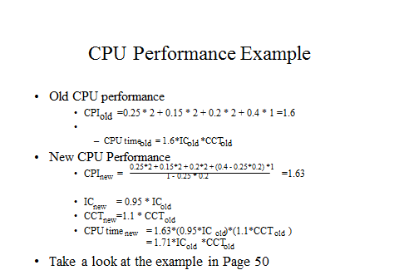

Slide 58
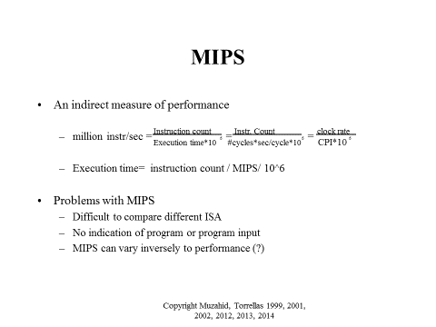

Slide 59
Consider a machine with the following instruction classes and CPI. Suppose we measure the code generated by two different compilers and get the following data.
Suppose clock rate is 500 MHz. Which code sequence will execute faster according to (i) MIPS and (ii) execution time?
Instruction Class | CPI
A | 1
B | 2
C | 3
Compiler | Instruction Count (Billions)
 | A | B | C
Compiler 1 | 5 | 1 | 1
Compiler 2 | 10 | 1 | 1

Slide 60
Sequence 1:
CC = (5*1 + 1*2 + 1*3)*10⁹ = 10*10⁹ cycles
Exec. Time = CC * clock cycle time = (10*10⁹)/(500*10⁶) = 20 sec
Sequence 2:
CC = (10*1 + 1*2 + 1*3)*10⁹ = 15*10⁹ cycles
Exec. Time = CC * clock cycle time = (15*10⁹)/(500*10⁶) = 30 sec
So, compiler 1 generates faster program.

Slide 61
Sequence 1:
MIPS = ((5 + 1 + 1)*10⁹)/(20*10⁶) = 350
Sequence 2:
MIPS = ((10 + 1 + 1)*10⁹)/(30*10⁶) = 400
So, compiler 2 has higher MIPS rating.

Slide 62
Megaflops
# of floating point operations in program
MFLOPS =
Does not measure integer performance
Assumes that same number and type of operations are executed on all machines
Changes with mixture of fast and slow operations (type of float pt. operations)
Execution time * 1,000,000

Slide 63
Summary
First taste of quantitative principles.
We studied Amdahl’s law, CPU performance equation.
Quantitative comparison of design alternatives.

